Slide 1

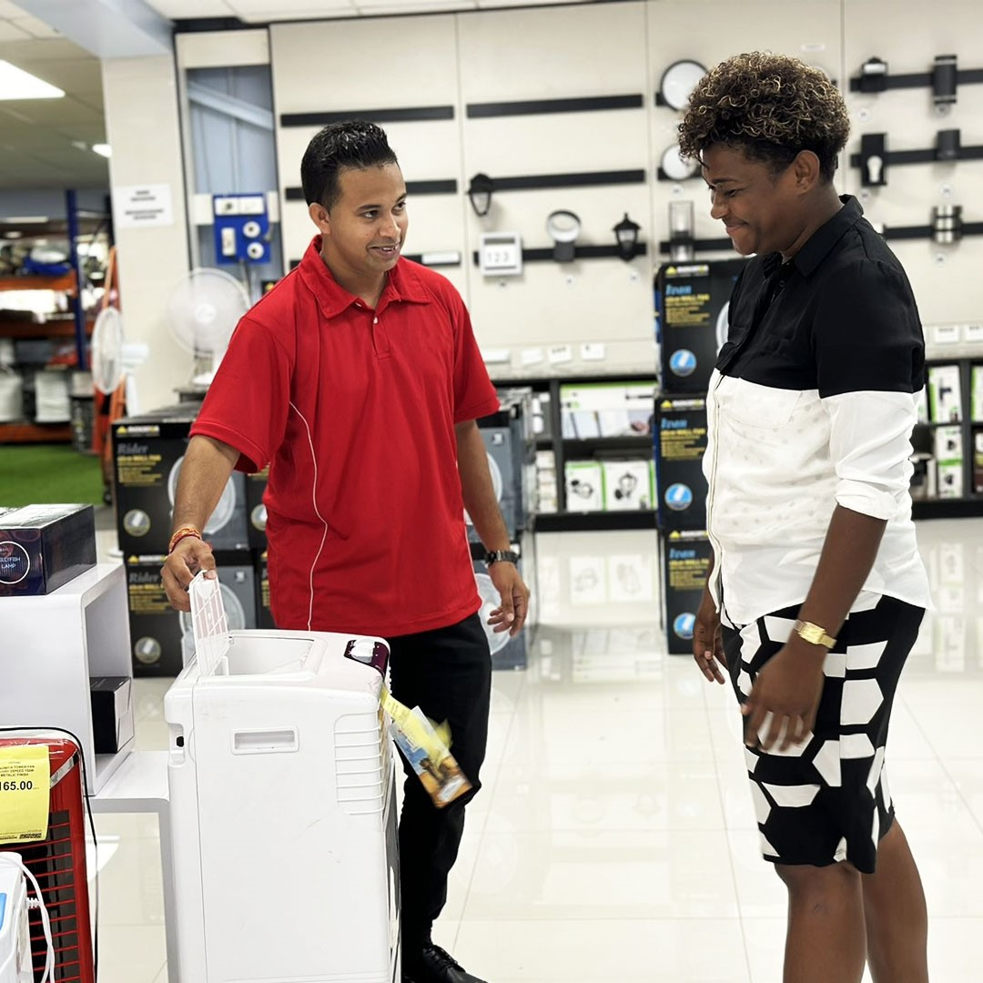






PRODUCT
TRAINING

Slide 2

Before we start, let’s now identify a few Important Things ….
HOUSEKEPPING RULES
Emergency Exit
Restroom
Mobile Phones

Slide 3

UNDERSTANDING SOLAR

Slide 4
https://youtu.be/GzQmo_Wd2Sw

Slide 5

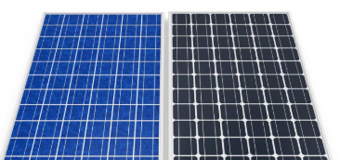
Identifying types of Panels

Slide 6
Video
https://youtu.be/zN6yG_euiZ8

Slide 7
Let's Jump into the Products!!

Slide 8
Solar Light Home Lightening System

Slide 9
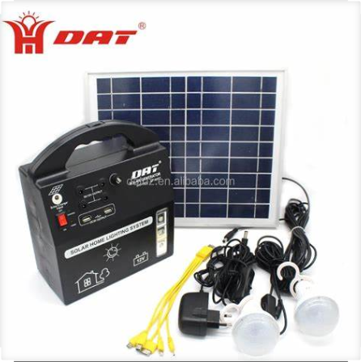
Solar Home Lightening System

Slide 10

AT-8207 Rechargeable 12v Battery High-power 10W Portable Solar Home Lighting System With 4pcs Bright Led Bulb

Slide 11

Comes with:
4 Lamps+
1pcs solar panel+
1 AC charging adapter +
5 in 1 Mobile phone charger

Slide 12
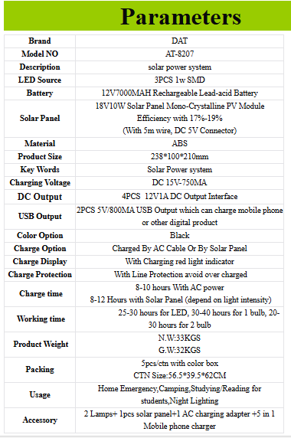

Slide 13

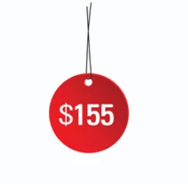

Slide 14
THE END
Thanks for your time!

